Slide 1
Capstone Project
Sporting Events System (SES)
Primary Module : Match module
www.collaberadigital.com

Slide 2
Profile Details
Past Experience : 4 years of experience with web development using Laravel and Spring boot across various domains such as Manpower and Business process Management.
Qualification : Bachelor of Science in Information Technology
Career Summary :
Java Developer : April 2019 – Present
Technology Stack :
UI technologies : Vue.js, Android
Back-end technologies : Java, Spring Boot, Laravel, Firebase
Database : SQL Server

Slide 3
Key Takeaways/Learnings from the Program (HTD)
Conducting thorough unit testing on the software to ensure high code coverage and quality.
Adhered to the best coding practices, writing clean code, identifying and resolving code smells using tools like SonarLint and SonarQube.
Utilizing JDBC and Hibernate ORM to perform database operations effectively.
Handling exceptions across all layers of the application for error handling.
Planning, designing, coding, testing, and debugging Java applications.
Testing REST API endpoints using Postman for reliable.
Applying practical knowledge of Spring Cloud modules such as Eureka Server, API Gateway, and Feign Client.
Implementing security features using the Spring Security module and JWT Token-based authentication.
Managing source code efficiently using Git repositories and hosting on platforms like GitHub.
Effectively managing project dependencies using Maven for streamlined project development.
Demonstrating the ability to work independently as well as in a collaborative team environment.

Slide 4
Sporting Events System Capstone Project
Primary Module : Match module
Develop a microservice that enables a system administrator to efficiently maintain various sporting events. The software should encompass the following essential functionalities:
User authentication and registration for other administrative accounts.
Efficient management of relevant data sets, including the creation, viewing, updating, and deletion of records.
Implementation of the microservice using the Microservices Architecture, along with Spring Cloud and Spring Boot REST API.

Slide 5
Program Learning Approach
Practical Hands-on Learning Approach
Adhered to the Agile methodology throughout the development process.
Collected requirements by acquiring User Stories.
Designed the architecture based on the capstone requirements.
Developed a relational database design.
Conducted unit testing in parallel with code development.
Resolved code smells to enhance code quality.
Collaborated with a trainer to review and ensure adherence to best practices in code writing.
Performed code refactoring based on feedback from the trainer or peers and retested the modified code.
Engaged in discussions with peer learners via Zoom breakout rooms to address bugs, fixes, and share best practices.
Explored different coding approaches to effectively solve problems.
Delivered presentations in class, facilitating peer learners to ask questions and solidifying understanding.
Participated in weekly quizzes and exams to assess comprehension of objectives.

Slide 6
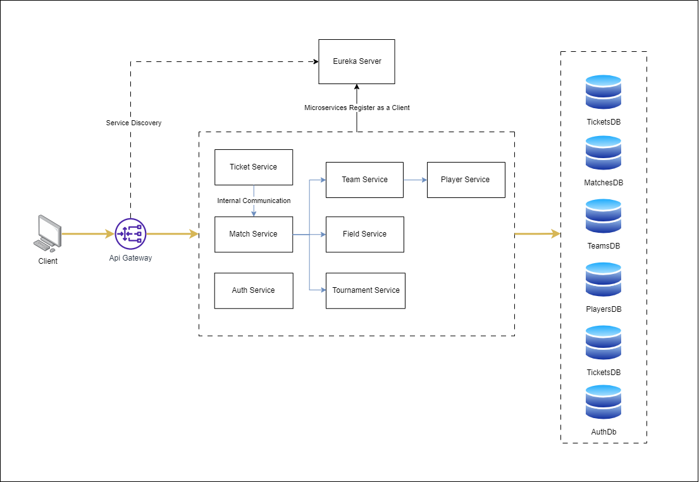
Wireframe/Architecture

Slide 7

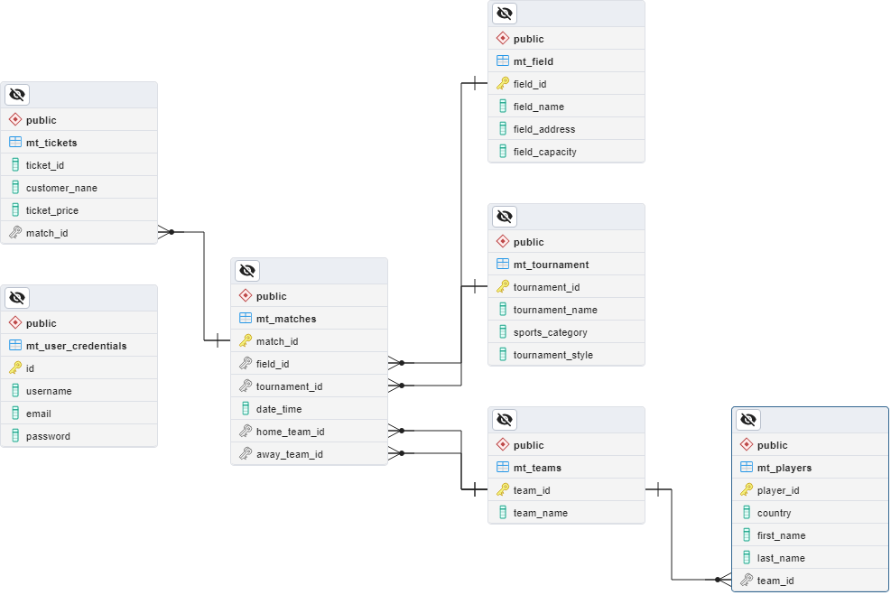

Wireframe/Architecture
www.collaberadigital.com

Slide 8
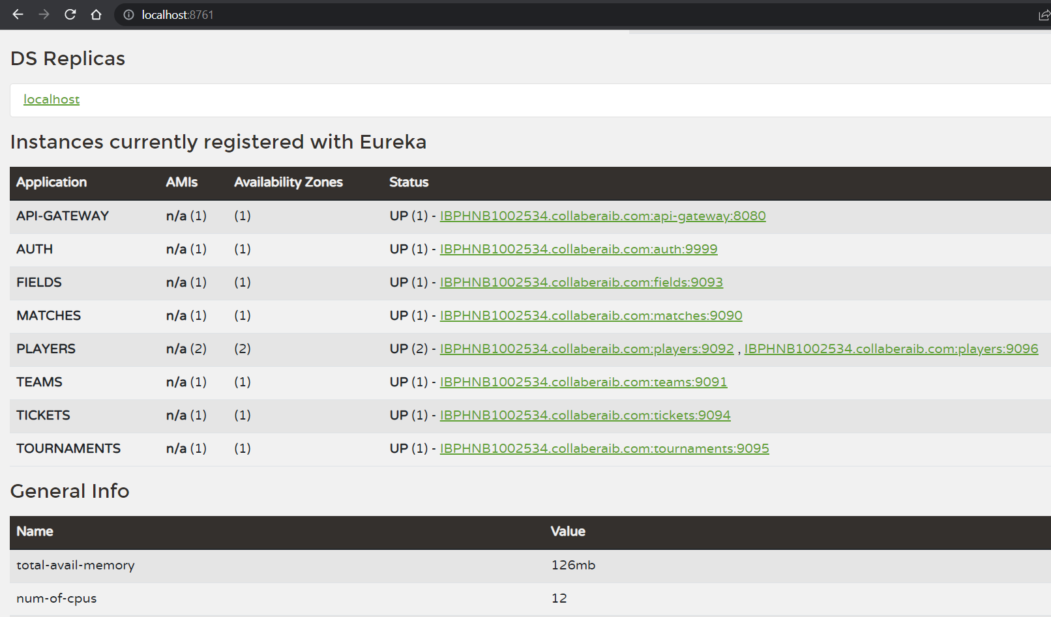
Eureka server
Services are registered in the eureka server and are accessed through an API gateway.
www.collaberadigital.com

Slide 9
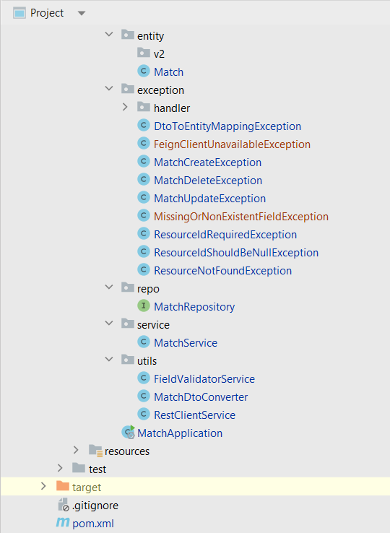
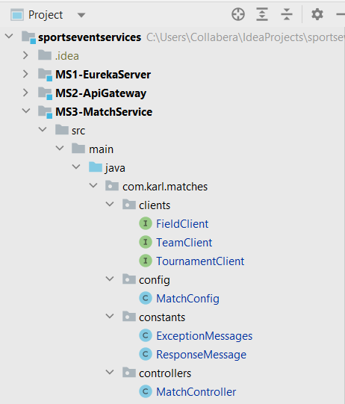
Project Structure
Tests were performed with Mockito and junit
www.collaberadigital.com

Slide 10
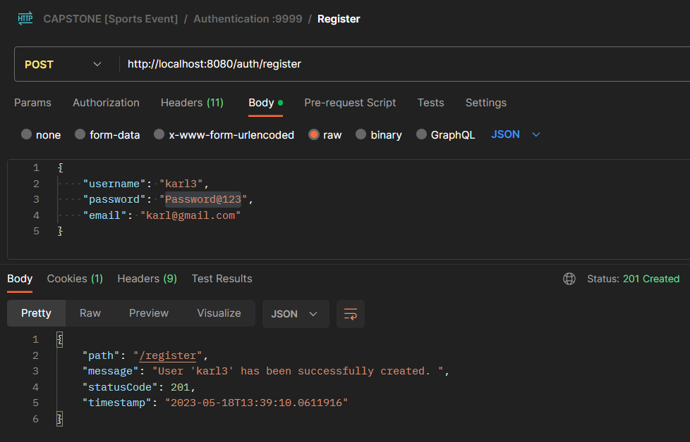
User Registration
Admins can register other users to access the api
www.collaberadigital.com

Slide 11
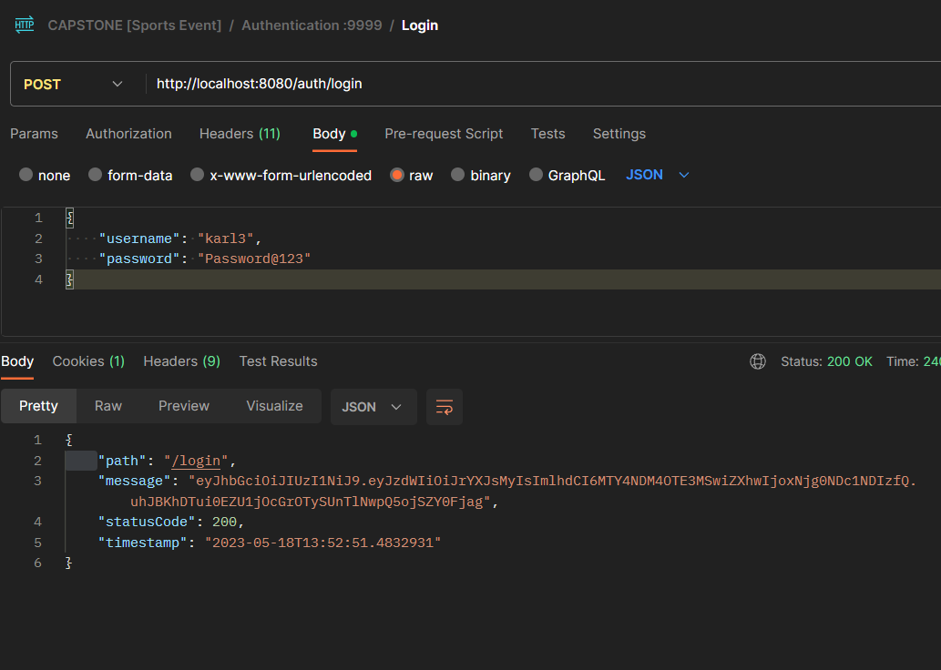
User Login
A JWT token is returned whenever a user login
www.collaberadigital.com

Slide 12
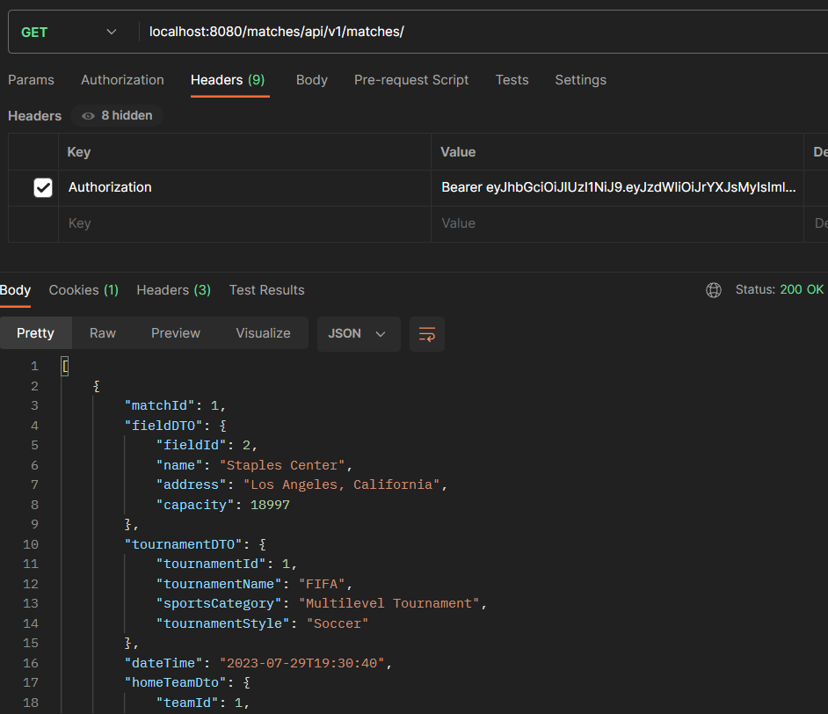
Match Service
Match service allows users to manage the sports matches
www.collaberadigital.com

Slide 13
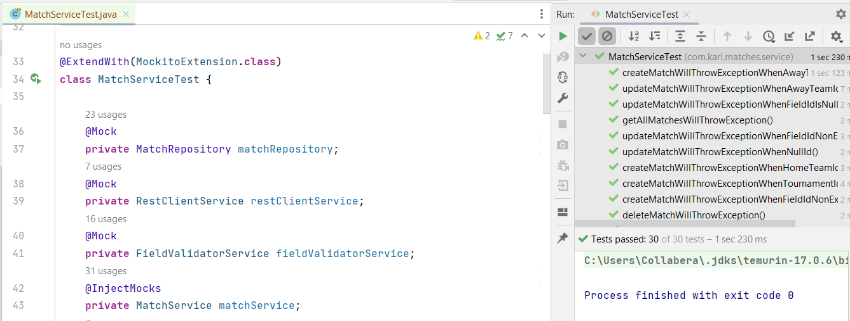
Project Testing
Tests were performed with Mockito and junit
www.collaberadigital.com

Slide 14
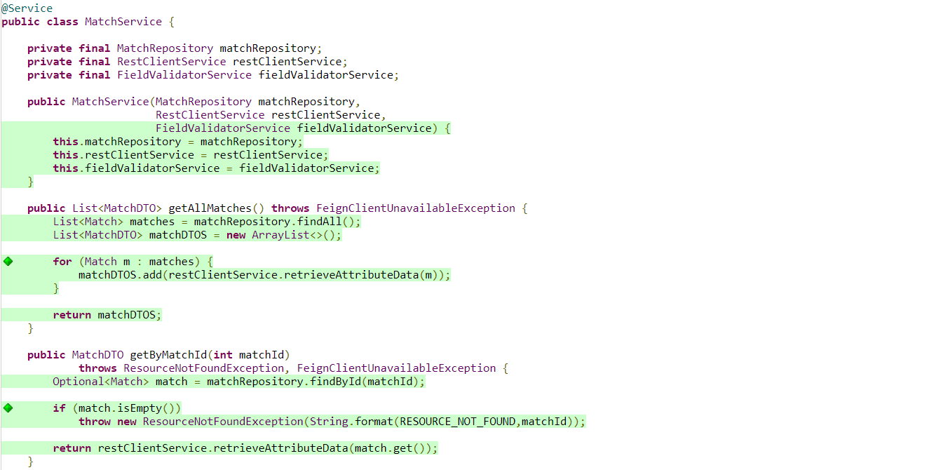
Code coverage
Reports are generated via jacoco plugin
www.collaberadigital.com

Slide 15
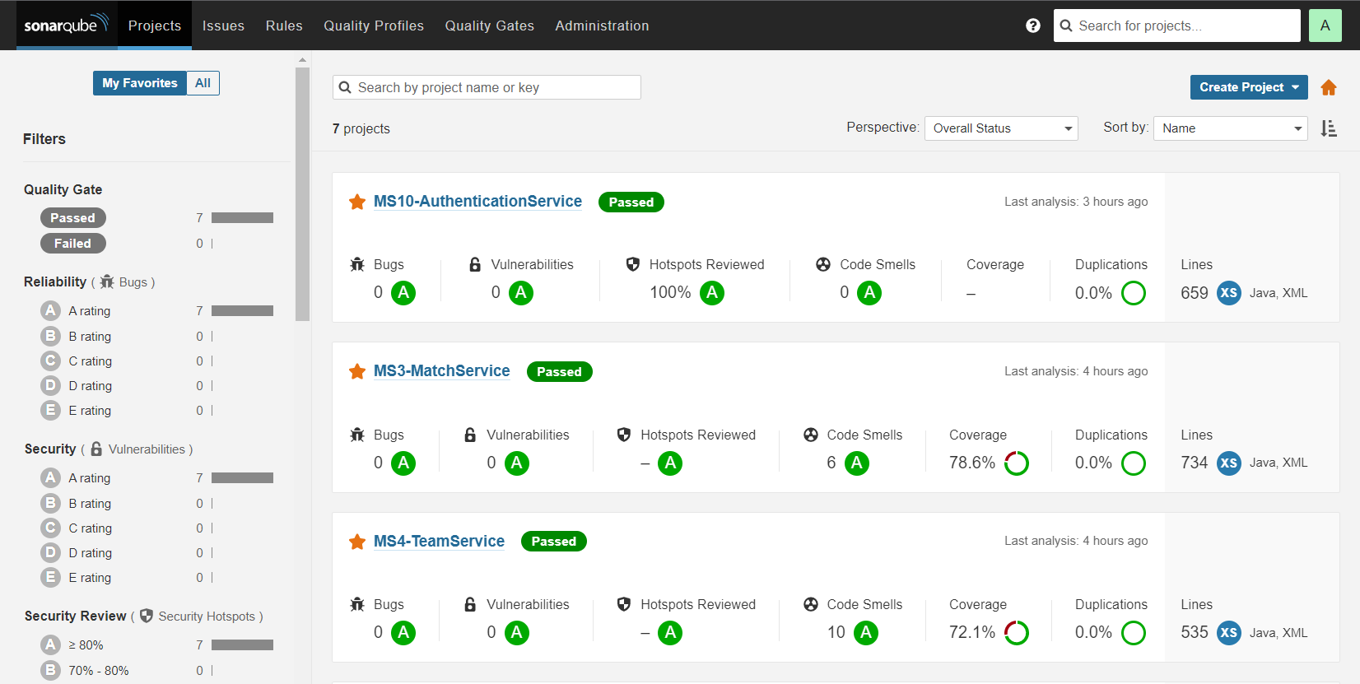
Code quality
Code quality is monitored by SonarQube plugin
www.collaberadigital.com

Slide 16
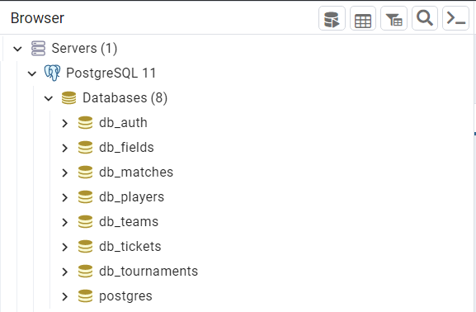
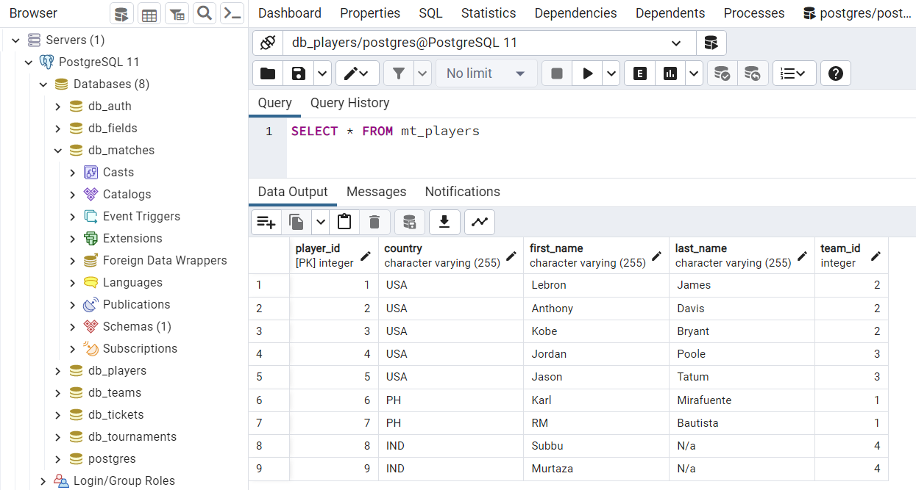
Database and Tables
Each service has its on database.
www.collaberadigital.com

Slide 17
Conclusion
By adopting a highly practical approach to learning microservices while implementing real world coding standards, the training has provided me knowledge and confidence building enterprise applications using the microservices architecture.
The project is built using a Microservices architecture with Service registry, api gateway and token-based security.
The services follow a one database per service rule and they are all loosely coupled.
Unit tests are highly prioritized to ensure the program stability.
High availability is implemented using multiple instances of the same microservice application and client side load balancing is performed.
An API gateway is registered in the Eureka server to handle API requests to various endpoints.
FeignClient is used to communicate between microservices.
The project is also code smell free with the use of SonarQube.
100% code coverage is ensured in Entity, Service, and Controller Classes with Junit testing and Mockito.
Validation, and proper exception handling is performed across various layers of the application.

Slide 18
Thank You
www.collaberadigital.com

